Slide 1
Center of Excellence
Servant Leadership

Slide 2

Is there only one type of leader?
No.
There are multiple types of leaders and leadership styles, all of them with different characteristics and best appliances.
Different leadership types lead to different results. Being a Leader means that we should be able to handle many types of leadership styles and be able to switch between them when needed. Part of becoming a Servant Leader is to know ourselves, to identify what kind of person/leader we are now and what we need to work on to become Servant Leaders.

Slide 3
Psychology-Based:
Autocratic
Democratic
Laissez-faire
Business-Oriented:
Task-Oriented
People-Oriented
Emotional-Based:
Visionary
Coaching
Affiliate
Pacesetting
Democratic
Commanding
How many types of leadership/Leader are there?

Slide 4
How many types of leadership/Leader are there?
Modern Leadership/Leader types:
Transactional
Transformational
Charismatic
Servant Leader

Slide 5
Psychology-Based Leadership/Leader Styles

Slide 6

Autocratic
These kind of leaders or leadership style demands compliance from the start.
This is the commonly called “do as you are told” leadership style.
It is useful when there is a situation that requires immediate action to be solved.
It is not useful when trying to modify a team’s behavior.
Abusing from it could lead to low team morale.
Types of Leadership/Leaders

Slide 7

Democratic
These kind of leaders or leadership style builds trust and achieves goals through consensus, voting or collaboration.
It is useful when implementing new processes or initiatives.
Usually gets SMEs (Subject Matter Expert) involved.
Types of Leadership/Leaders

Slide 8

Laissez-faire
These kind of leaders or leadership style look to build a strong team that can do any assignment without being involved.
It is the opposite of the Autocratic style.
Individuals are given loosely defined objectives and goals.
Creativity and innovation are well appreciated in this style.
It can be a burden to people who look to have very well-defined goals.
Types of Leadership/Leaders

Slide 9
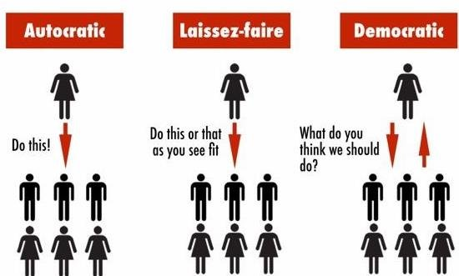
Psychology-based Leadership/Leader Types
Types of Leadership/Leaders

Slide 10
Business-Oriented Leadership/Leader Styles

Slide 11
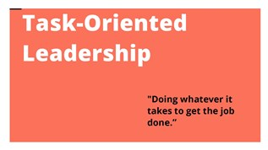
Task-Oriented
These kind of leaders or leadership style focus on result-driven outcomes
Give clear communication of objectives and outcomes
Does not take into consideration if the right person is assigned to the task.
Types of Leadership/Leaders

Slide 12

People-Oriented
These kind of leaders or leadership style focuses on determining if the right person is assigned to the task at hand.
Considers current skill set, interest and personal development.
Promotes development by assigning tasks outside of an individual’s comfort zone.
Types of Leadership/Leaders

Slide 13
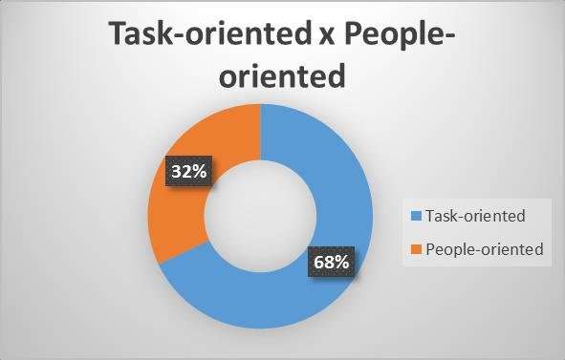
Task-Oriented Leadership vs People-Oriented Leadership
Types of Leadership/Leaders

Slide 14
Emotional-Based Leadership/Leader Styles

Slide 15

Visionary
These kind of leaders or leadership move people towards a vision.
It is said to be the most impactful style.
Gains strength through passion and vision.
Empowers and inspires the team.
Promotes innovation and creativity.
Conveys the vision and gets out of the team’s way.
Types of Leadership/Leaders

Slide 16
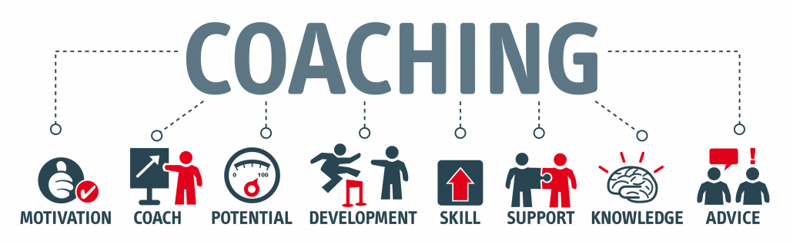
Coaching
These kind of leaders or leadership style focus on achieving progress.
Prepares people for the future.
Considers that every individual on the team needs coaching in some capacity.
Types of Leadership/Leaders

Slide 17

Affiliate
These kind of leaders or leadership style focus on creating bonds with the team.
It is the “people come first” style in the sense that they try as much as possible to create and build a bond or relationship with their team.
Does work best when there is a lack of motivation within the team.
It is important to leverage when talking to senior directives, as “you” reperesent the team, as they chose you.
Types of Leadership/Leaders

Slide 18

Pacesetting
These kind of leaders or leadership style expect excellence and self-direction.
Prone to set high standards without considering other people’s ideas.
Might damage morale or cause feelings of inferiority among the team when used.
Types of Leadership/Leaders
Notes:
It can end up being overwhelming to the team due to the high demands, workload and pressure.

Slide 19
Modern Leadership/Leader Styles

Slide 20
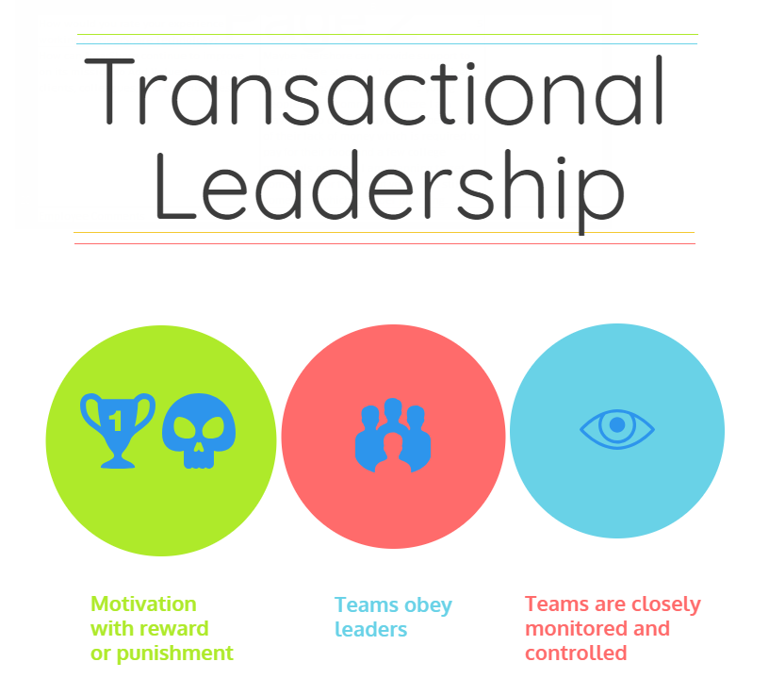
Transactional
These kind of leaders or leadership style focus on day-to-day operations.
Has challenges seeing the “big picture” or a vision.
Focus on an individual’s goals and responsibilities.
Agressively manage team members that do not meet expectations, which causes low morale.
Types of Leadership/Leaders

Slide 21
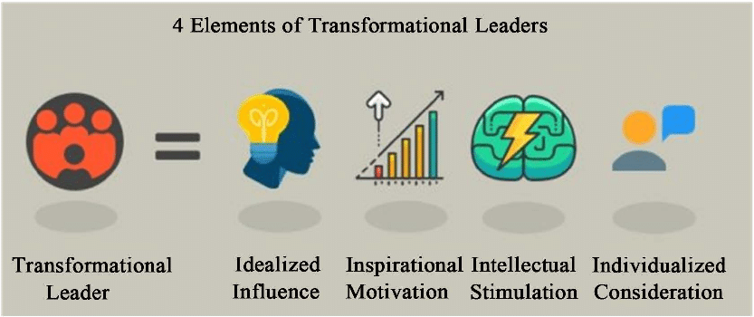
Transformational
These kind of leaders or leadership style focus on transforming their organization to the next level
Lead with high-performance and engaged teams.
Uses clear communication, conveying vision, integrity, emotional intelligence, authenticity and self-awareness.
This is the most common leadership style in business.
Types of Leadership/Leaders

Slide 22

Charismatic
These kind of leaders or leadership style encompasses the components of transformational leadership by inspiration and motivation.
However, their goal is not the benefit of the organization, nor their excellence and growth.
The goal of these kind of leader is their own benefit.
This style has led to the demise of many organizations.
Types of Leadership/Leaders

Slide 23

Servant Leader
Servant Leadership is defined as the natural desire to lead by serving others.
Meeting the needs of the team members, empowering them to make decisions, focusing on growth, ensuring that their basic needs are met.
Servant Leaders are, many times, not formally recognized, as they are usually unknown and focuses the spotlight on the team members to show success.
Types of Leadership/Leaders

Slide 24
Servant Leader
Servant Leadership benefits are:
  Higher engagement, which leads to higher performance.
  Team members feel valued and have greater sense of engagement.
  Team members feel the leader cares about them and their well-being.
  High team morale.
A servant leader leads with high integrity, focuses on the good of the organization as well as the team members, has concern with the stakeholders and exhibits a high degree of self-awareness.
Types of Leadership/Leaders

