Slide 1
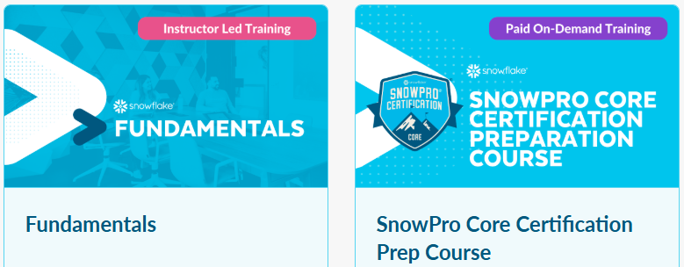










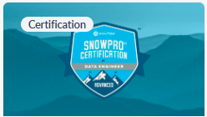

Snowflake CoE Career Path
Collaboration, Marketplace & Cost Estimation Workshop
(Badge 2)
Data Lake Workshop
(Badge 4)
Data Warehousing Workshop
(Badge 1)
Data Application Builders Workshop
(Badge 3)
Data Engineering Workshop
(Badge 5)

Slide 2


Data Warehousing Workshop
(Badge 1)
This course is the first in the Hands On Essentials Series. This series allows you to earn a Badge for display on LinkedIn and other social media. The Essentials Series uses active learning principles to give you a fast paced, hands on experience. Short videos, step-by-step labs, reflection questions, and challenge labs work together to build your knowledge and skills as you build a solution.
Training Program:
Benefits of a Cloud-based Database
Account Editions, Regions & Clouds
Snowflake Identity, Access, Users, & Roles
Databases, Ownership and Context
Worksheets and Warehouses
Loading Tables Using SQL Insert Statements
File Formats, Stages, and Copy Into Loading
Semi-Structured Data including XML and JSON
Querying Nested Semi-Structured Data
Prior Knowledge & Experience
As our flagship course, there are no prerequisites. You should know how to use a web browser but beyond that, you don't even need to know what a database is! It does NOT require prior experience with Snowflake.
Badge 1

Slide 3
Collaboration, Marketplace & Cost Estimation Workshop (Badge 2)
This workshop is the second workshop in the Hands-On Badge Series. In this course, you deep dive into Snowflake's revolutionary collaboration technologies including the Marketplace and direct share listings. Start by exploring the inbound shares that come with every trial account. Understand how shared and local data can be used together. Create a listing to share with another Snowflake account, and accept a listing shared with your Trial. Shop for listings on the Snowflake Marketplace, add a free data set from WeatherSource and combine that data with local data to generate new insights. Understand how your organization's business partners can be given access to your data shares. Learn how to control costs with Resource Monitors.
Training Program:
Snowflake's revolutionary collaboration technologies. Learn to create listings, get listings sent by other accounts, and shop for data sets on the Snowflake Marketplace.
Understand how your organization can get rid of nightly extracts and cumbersome ETL processes.
Helps those new to SQL brush up on some important SQL skills including basics like DISTINCT, GROUP BY, ORDER BY, JOINS, and control-of-flow like BEGIN, END, DECLARE and FOR.
Finally, the course covers cost categories, cost estimation, and some beginner-level cost control mechanisms.
Prior Knowledge & Experience
We strongly recommend completing the Data Warehousing Workshop (Badge 1) before attempting this workshop. Many foundational concepts are covered in Badge 1. The course instruction presumes you have completed Badge 1 and does not explain all concepts from the introductory level.
Badge 2
Badge 1

Slide 4

Data Application Builders Workshop (Badge 3)
This builders workshop sets you up with all the tools and concepts you need to get data into, and out of Snowflake with end-user friendly interfaces. You don't need to have any prior experience with coding languages. As long as you have completed your Hands-On Essentials Data Warehousing Workshop (DWW) Badge, and your Collaboration, Marketplace, and Cost Estimation Workshop (CMCW) you know what you need to know to be successful in this course.
Training Program:
DABW provides beginner-level exposure to key app builder tools like Streamlit, Python, GitHub, and Web Services Rest APIs.
Short introduction to Streamlit App development, then depart on a journey through deeper dives into different tools and skills needed to built more robust Apps.
DWW introduced you to External Named Stages (S3 bucket), file formats, semi-structured data loading and querying, and COPY INTO statements. In this course, we'll use an Internal Named Stage and come to understand how they differ from external stages.
Prior Knowledge & Experience
You need to have experience using Snowflake, either with six months of independent use or having earned Hands-On Essentials badges 1 and 2.
Badge 3
Badge 2
Badge 1

Slide 5
Data Lake Workshop
(Badge 4)
This course is the 4th in the Hands On Essentials Series. The Hands On Essentials Series is designed for beginner-level data professionals. This series allows you to earn a Badge for display on LinkedIn and other social media. The Essentials Series uses active learning principles to give you a fast paced, hands on experience. Short videos, step-by-step labs, reflection questions, and challenge labs work together to build your knowledge and skills as you build a solution.
Training Program:
Data Lake Workshop (DLKW) covers non-loaded data and the tools you can use in Snowflake to access and analyze that data.
Learn about non-loaded data, unstructured data, GeoSpatial data, and hear about the Iceberg tables.
Parquet and GeoJSON data, and image data.
Run GeoSpatial Functions and create your own User Defined Function.
Prior Knowledge & Experience
We strongly advise completing the Hands On Essentials Series in order (Badges 1, 2, and 3 before this 4th badge) as these workshops put learners in the best position to succeed in this workshop. In lieu of earning the previous badges, six months of hands on Snowflake usage could be substituted.
Badge 4
Badge 3
Badge 2
Badge 1

Slide 6
Data Engineering Workshop
(Badge 5)
This workshop is the 5th in the Hands On Essentials Series. The Hands On Essentials Series is designed for beginner-level data professionals. This series allows you to earn a Badge for display on LinkedIn and other social media. The Essentials Series uses active learning principles to give you a fast paced, hands on experience. Short videos, step-by-step labs, reflection questions, and challenge labs work together to build your knowledge and skills as you build a solution.
Training Program:
Data Engineering Workshop (DNGW) teaches workshop participants about the role of Data Engineers in Data-Driven organizations and allows the learner to get hands on experience with date and time data types, tasks, pipes, merge statements, and more.
Highly interactive with reflection questions, hands on lab work and automated lab work checks! Fast-paced and informative, light in tone, scenario-driven and metaphor rich.
Prior Knowledge & Experience
We strongly advise completing the Hands On Essentials Series in order (Badges 1, 2, 3 & 4 before this 5th badge) as these workshops put learners in the best position to succeed in this workshop. In lieu of earning the previous badges, six months of hands on Snowflake usage could be substituted.
Badge 5
Badge 4
Badge 3
Badge 2
Badge 1

Slide 7
AWS, Azure and Python
To complete your training as Snowflake data engineer you can visit Analytics CoE, where you can find the guide to get knowledge for Azure Data Engineer, AWS Data Engineer and Analyst, you can combine these services using python code to build data structures and more.
Training Program:
Visit Analytics CoE

Slide 8

Text
Text
Text here
Text here
Text here
Text here
Text here
Machine Learning Practitioner

